Slide 1
Risks and benefits of
LEGO
diversity habits in hiring and marketing
Nicholas Skinner
Notes:
Change ‘Company Name’ to the company you chose from the Diversity instructions.
Add your name.

Slide 2
Instructions
For each page, synthesize your research and write in complete sentences in essay format using 14pt type.
Write about topics/questions provided in the Notes below each page.
Add additional pages if you need more room.
If an area doesn’t seem to fit your topic, then broaden your research to include similar issues.
When in doubt, write the instructor for clarification using the Canvas Inbox.
Cite sources by using hyperlinks in the Titles of the Articles and Titles of Laws. See the examples on the Writing Requirements page.
Add at least one piece of media that provides additional information:
Using the Insert menu above, add a video, chart, infographic, or diagram to support what you’re writing about (not logos).
Cite media with copyright statements: © year Owner Name.
Hyperlink the copyright statement so we can view to the movie in a new tab. (Google PDF files do not allow viewing of the movie.)
Add all sources to the Bibliography page.
Include author, title, publisher, date, and URL.

Slide 3
General Description
LEGO provides a number of toy products
that are seen as the ‘building blocks’
toward engineering and construction. The
actual product is a number of bricks that can interlock, and all combine to create a structure, but the parts can be taken apart and combined with other sets to create something unique from within the child’s imagination.
Employee demographics
LEGO displays their employee demographics in their annual update. At the moment, lego is focused on creating a gender equal work environment, and as of 2015 had a worker base that consisted of 54.6% male, and 45.4% female. LEGO also reported the number of females appointed to management positions. This is displayed in their non-financial report on their website, within said report, they display that 43% of their total manager base is female, and they are looking toward having a balanced composition of genders in managerial positions by 2032.
CUSTOMER DEMOGRAPHICS
According to Infoscout.co’s data, A Lego customer is generally in a high income bracket, Asian or Caucasian, and on the lower end of middle age. The product is also more likely to be purchased by females, couples with children, and those that have a college education and above. While the gender spread is roughly eve, the racial spread is much more severe, the product is most popular with caucasians, and asians. Mildly popular with hispanics, and not very commonly purchased by African Americans.
PROFITS
LEGO also releases an annual report on their website on their profits. Their reports also contain information related to previous years reports so that the user is able to view how the company is growing over the last number of years.
Notes:
Describe the Company’s products, services, employee demographics, customer demographics, and profits. Start with their website then search other sites.

Slide 4
Diversity Statements
LEGO has gone out of their way to to make
Their company a diverse and inclusive place to
Work. Their official website states that
they were the first company within the toy industry to subscribe, follow, and sign onto the non-mandatory United Nations Global Compact. The UNGC website attests to this, showing a Communication On Progress section that displays their annual reports on the progress, from 2003 onward, that had been made in the organization to adhere to the UNGC’s ten Principles.
Lego also claims on their website that they are desiring a more gender balanced flow of talents to contribute to their organization to assist in tackling global challenges such as gender and racial diversity. They have since displayed their progress on this initiative in their annual non-financial updates. They hope to achieve this goal sometime around the year 2032, but have already made substantial headway on it.
Notes:
Write about the Company’s diversity initiatives.
Does the Company have a diversity statement on their website?
If not, what other sources make note of their diversity initiatives?
If so, do they just ‘comply’ with diversity initiatives, or are they part of their ‘business strategy’?

Slide 5
Actual Diversity
LEGO has made many strides in diversity of management in order to
achieve their goal of an equally gender diverse management team by
the year 2032. From the year 2011 to 2015 LEGO was capable of
changing the individuals their management level from ~75% male and ~25% female to ~57% male and ~43% female, almost doubling the number of women in those positions. The Annual non-financial report displays more detail in levels of management, and the % of genders in the respective level. In these more specific categories, women have a larger position in the ‘other’ and 1st tier management categories, and then compose almost a third of the two upper divisions.
As far as Race goes, LEGO does not seem to explicitly state any percentages of ethnicities that work for the company. It is somewhat implied that the largest demographics of employees are caucasian, and asian, as their main business locations are in Asia, Europe, and the Americas, but no specific details are immediately available.
LEGO reports ages of employees in their annual review, and they also separate top level management, middle management, and management. There is also a catch-all term for employees that aren’t in management, these employees are categorized as ‘other’. In all of these classifications of positions, employees within the age range of 30 to 50 are dominant, with those under 30 years old composing a large slot of the lower sections known as ‘other’ and those above 50 being sprinkled through each of the sections with some low representation.
Notes:
Write about the Company’s various teams, such as board of directors, executive, management, production, and marketing, as applicable.
What percentage of employees are minority or international?
Describe each team’s general:
Culture
Race
Gender
Age
Class

Slide 6
Recruiting & Hiring Laws
As stated in their Code of Conduct
Webpage LEGO follows,
and encourages its vendors and
employees to comply with ILO and UN Conventions, in addition to acting in accordance to the local labor laws, including but not limited to Minimum wage, child labor, and freedom of movement. LEGO also highly discourages discrimination with the following statement on their code of conduct:
“Discrimination, directly or indirectly, in hiring and employment practices on grounds of race, colour, sex, language, religion, political or other opinion, age, national, social or ethnic origin, property, sexual orientation, birth or other status must not be engaged in or supported.”
In addition to that statement, LEGO has also taken a firm stance saying that women should not need to be subject to mandatory pregnancy tests, and employees should not be subjected to mandatory HIV/AIDS testing
According to LEGO’s annual non-financial report, Lego has made an attempt to broaden diversity in the company by having a goal where 50% of its managing staff is female, at the time of this declaration, about 23% of the managing was female, and as of 2015, that number had changed to 43%. Their end goal is 50% of the managing staff to be female by the year 2032, but they appear to be well on their way to achieving that goal. Their statements for this change are all about creating a more diverse team to create a better-rounded product for the end-customer, as well as get additional influencers with different backgrounds and outlooks on their team.
Notes:
Write about the Company’s Job Recruiting descriptions.
What standard disclaimers and notices of laws do you see in job postings? Do they encourage diverse groups to apply?
Describe the main concepts and acts found in the company’s materials:
Equal Opportunity Employer
Affirmative Action
Fair Chance Ordinance
Pay Transparency Nondiscrimination Provision
Department of Labor
United States Citizenship and Immigration Services E-Verify service
ADA accommodations
Internship
Apprenticeship
Unions
Veterans Preference
Diversity initiatives
Diversity statement
others?

Slide 7
Marketing & Advertising
LEGO will send users that have entered their
email account notifications reminding the
user that there are items in their online shopping cart, and will also pimp out new products through email. The new products that they will display are often determined by an algorithm that determines what advertisements to show based on previous purchases, and other information it may know about customers. The customer is also able to select how often they wish to receive emails about LEGO products, whether they would like a daily, or weekly email, or if they wish to opt out, and not receive emails, the options to do that are sent with the email, and attached at the bottom. With all of this information they send in their emails, they must also act in accordance with the CAN-SPAM Act, and as described above, they are in compliance with these rules, they send messages with an unsubscribe button at the bottom, their emails are only sent to account members, and are not harvested from other databases, they are sent with a proper header, and at least a sentence for every line preventing the message from being null.
Notes:
Write about the Company’s advertisements in print, online, or in video media.
Describe their use of these advertising strategies:
Bait advertising
Endorsements
email advertising, Spam and CAN-SPAM Act
Opt-in and Opt-out
Search ads
Adwords
Affiliate Marketing
Analytics
Data mining
Testimonials
Truth in Advertising Laws
Others?

Slide 8
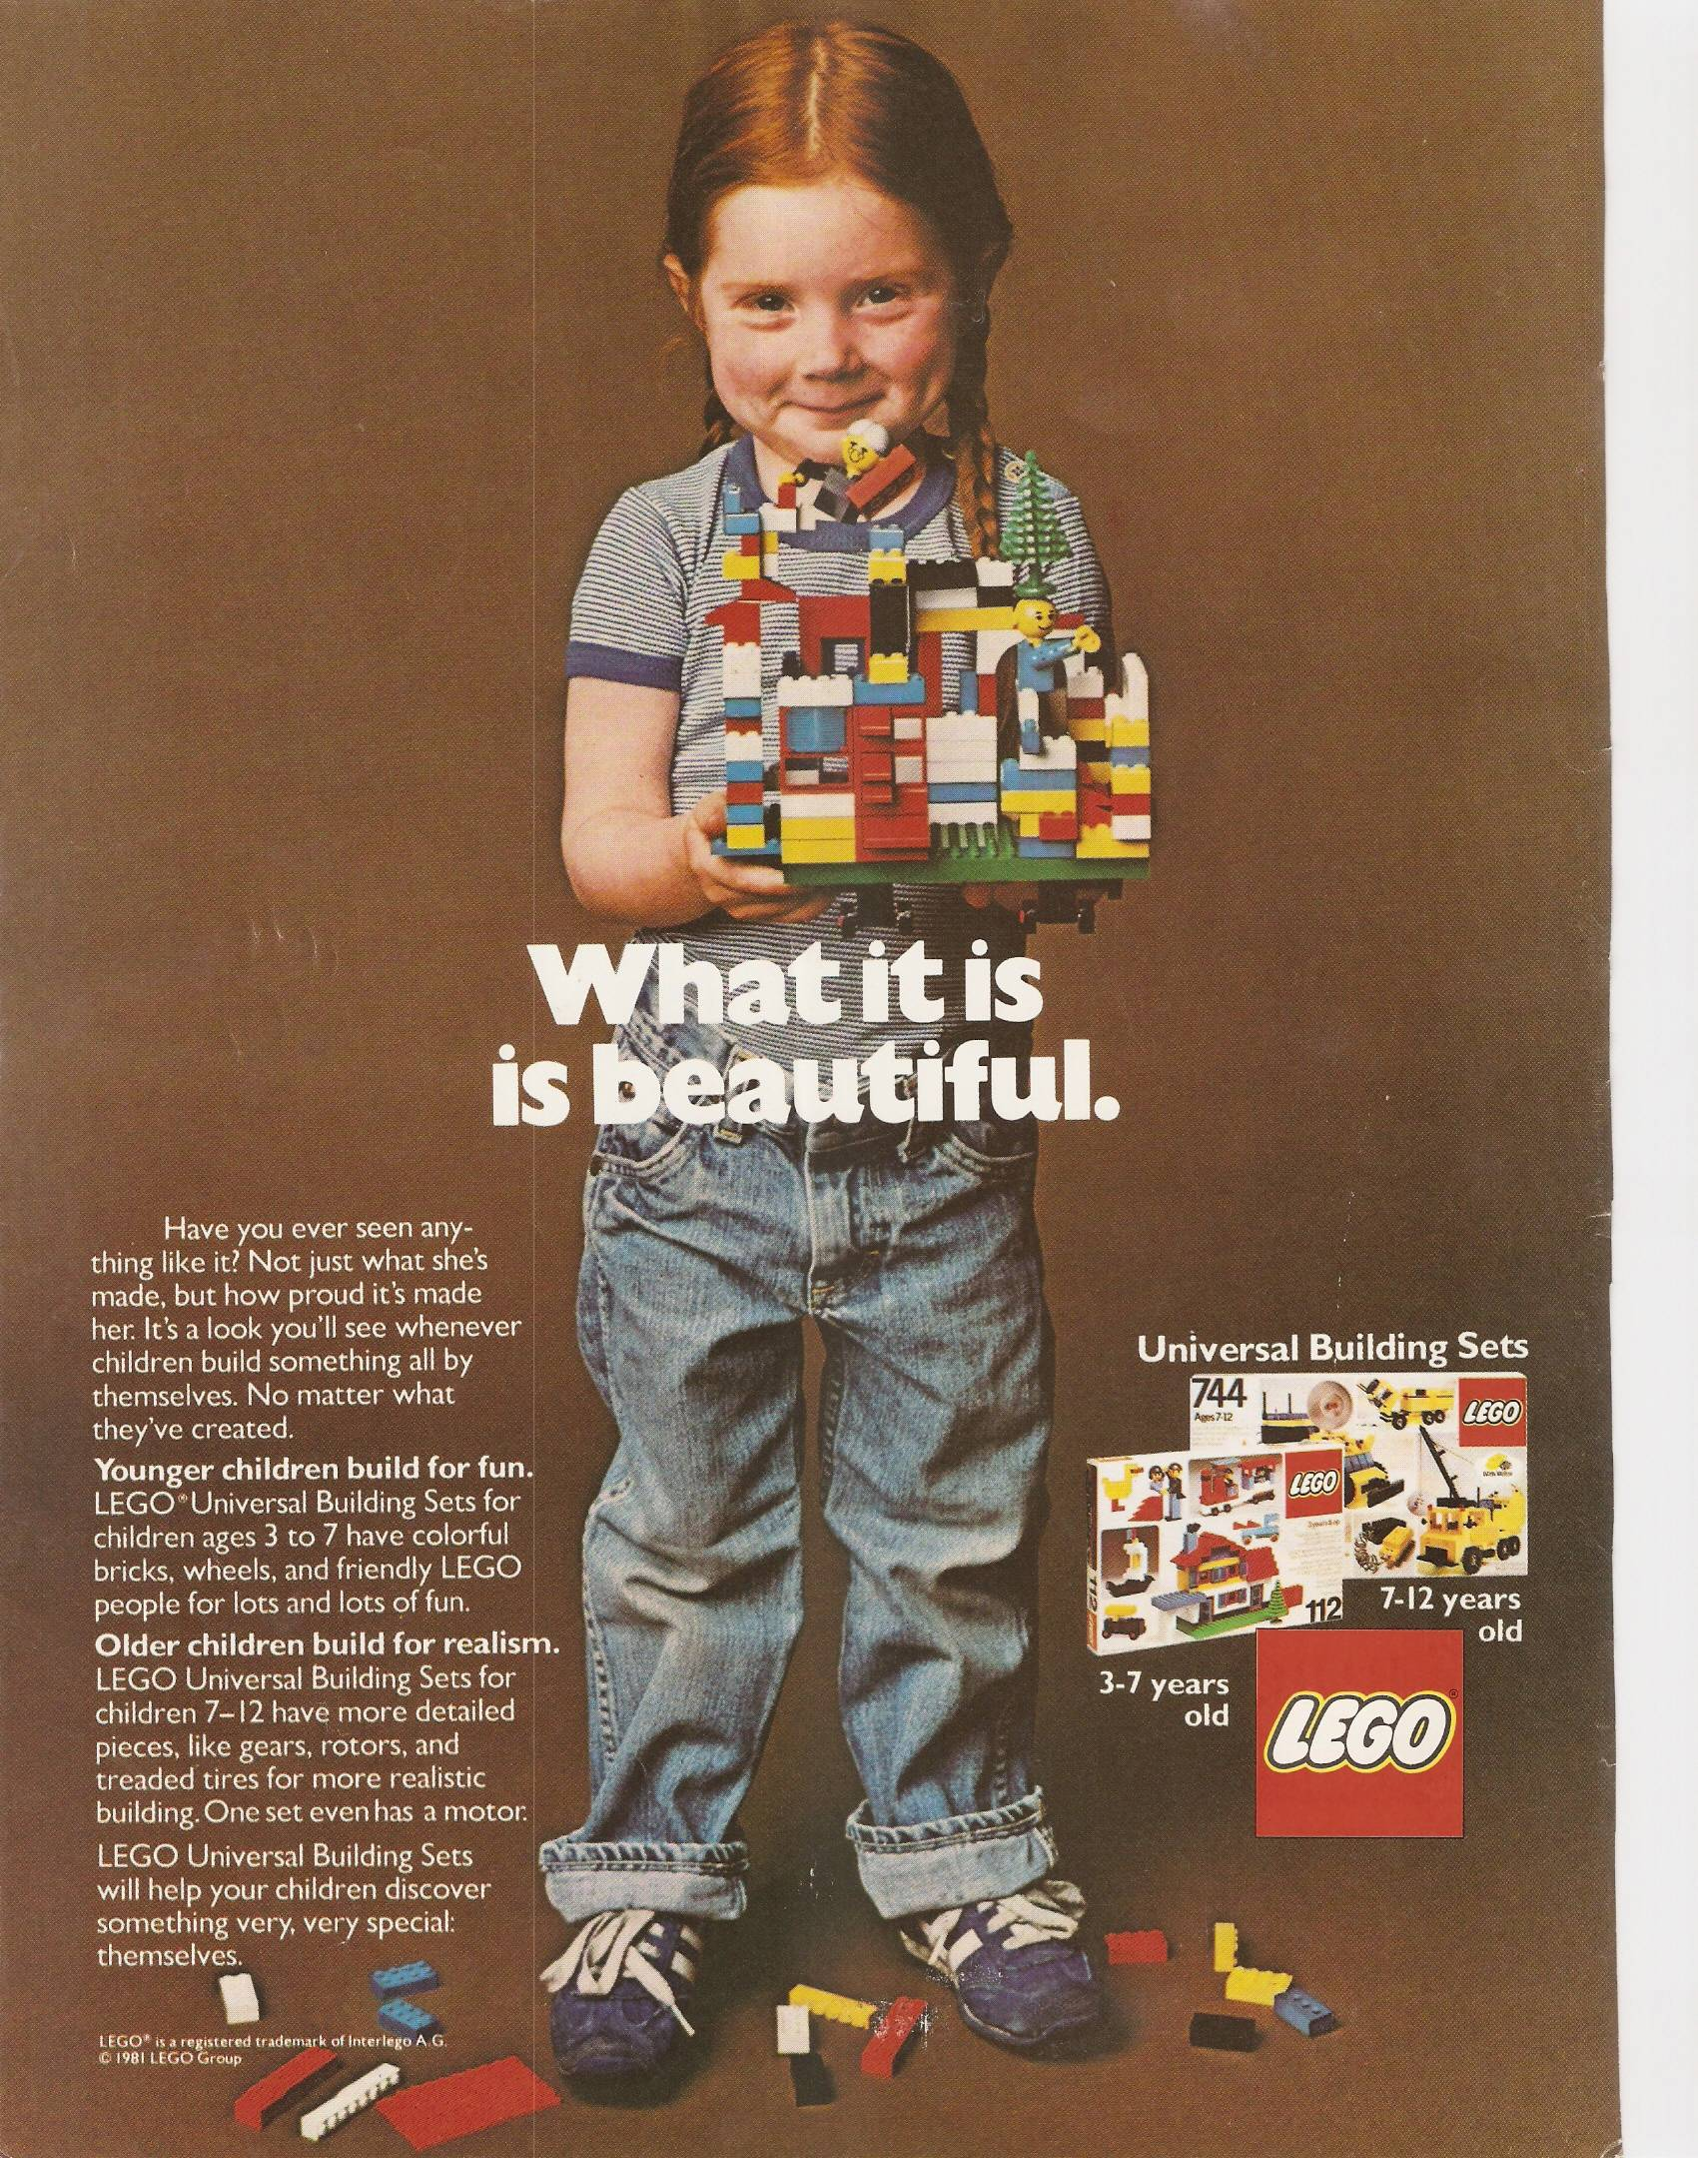
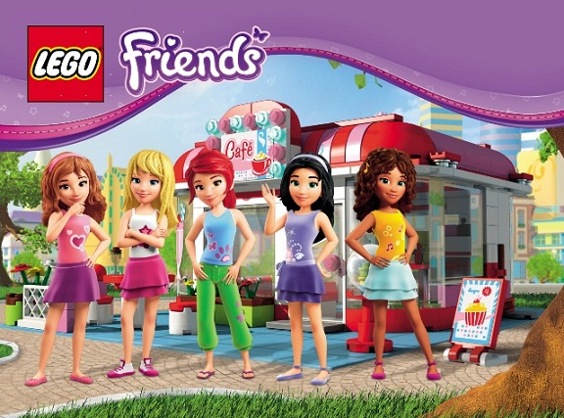
Media Advertisement
The image on the right is from a 1981 LEGO advertisement, it depicts a
young girl who is holding a lego creation, and she looks awfully
proud of it. This image is a stark contrast of many people’s
stereotypical thoughts of what a girl’s toy and what a boy’s toy
Were, at the time, and even to this day. It also displays a contrast between
the more gender agnostic advertising of these ads vs the modern product
lines that lego has provided. This advertisement depicts a ‘Universal
Building Set’ that people may view as more male oriented while the modern
product lines have more feminine oriented lines like ‘LEGO Friends’ line
shown below. The bottom advertisement displays the more traditional idea
of a feminine toy, feminine colors, and more centered on the characters
than the product. While LEGO is very diverse and progressive in its staff
Composition, its gender agnostic approach may have faded a bit.
©LEGO, 2012 © Huffington Post 2014
Notes:
Using the Insert menu above, add an image or video of a diverse advertisement from this company, and/or one that shows a lack of diversity.
Describe the ad’s overall depiction of Culture, Race, Gender, Age, and Class stereotypes or lack thereof.
Cite using a copyright statement.

Slide 9
Data Mining
LEGO appears to use their online accounts to gain data and insight into
the customer, they have databases that show what the user puts in
their cart, what they have purchased, what the user has on their
Wishlist, and products that the user has viewed. LEGO are also able to view the frequency of hits certain products in general on their store get compared to others, and how well those items sell may give insight to the direction to take the products.
One of my sources, Infoscout.co has a slightly more precise system, their method is listed toward the footer of their website:
InfoScout has over 300,000 shoppers uploading their shopping receipts (paper and electronic) through our portfolio of mobile apps. Receipts and behaviorally triggered surveys allow us to provide brands with real-time omnichannel shopper and consumer insights.
With using these sample groups, Infoscout is able to create a much more precise estimate into what the average one who purchases lego will be. This kind of information can help LEGO know what locations to advertise more towards, what demographics their customers are, and what days people are more likely to purchase their product. This data only partially helps LEGO though, as LEGO also needs to understand the products that children are more interested in, in order to stay relevant to the children.
Notes:
Write about how the Company learns about their customers’ demographics and purchasing habits. Describe these advertising concepts:
Cyberpsychology
Algorithms
Analytics
Data mining
Demographics
Purchasing habits
others?

Slide 10
👍
This company earned…
A thumbs up, LEGO have gone out of their way to diversify staff gender, and comply with non-mandatory UN recommendations on how to approach diversity.
Notes:
Based on the research, do you consider the Company to be diverse?
Give it a thumbs up or thumbs down. (Delete the unused emoji.)
Write a sentence or two to explain your decision.

Slide 11
Bibliography
"LEGO A/S | UN Global Compact." LEGO A/S | UN Global Compact. N.p., n.d. Web. 05 Mar. 2017.
https://www.unglobalcompact.org/what-is-gc/participants/6097-LEGO-A-S#company-information
"How Lego Harnessed Diversity to Build an Innovation Culture." Chartered Managment Institute. N.p., n.d. Web. 05 Mar. 2017.
http://www.managers.org.uk/insights/news/2015/may/how-lego-harnessed-diversity-to-build-an-innovation-culture
"Annual Report." The LEGO Group - About Us LEGO.com. N.p., n.d. Web. 05 Mar. 2017.
https://www.lego.com/en-us/aboutus/lego-group/annual-report
The LEGO Group CODE OF CONDUCT (n.d.): n. pag. LEGO.com. LEGO. Web. 05 Mar. 2017.
http://cache.lego.com/downloads/info/Codeofconduct/CODEOFCONDUCT_English.pdf
RAE, HANIYA. "Lego's Aggressive Brick-by-brick Marketing." Digiday. N.p., 15 Feb. 2014. Web. 05 Mar. 2017.
http://digiday.com/marketing/lego-movies-saturated-ad-strategy/
Notes:
For each source used in the previous pages, document the author, title, publisher, publish date, and URL.

Slide 12
Bibliography
Virgillito, Dan. "What Can You Learn From LEGO’s Content Marketing Strategy." AdEspresso. N.p., 28 Sept. 2015. Web. 5 Mar. 2017.
https://adespresso.com/academy/blog/lego-content-marketing-experience/
"Lego Consumer Insights and Demographics." Infoscout.co. N.p., n.d. Web. 05 Mar. 2017. http://infoscout.co/brand/lego/
"Our Policies and Reporting." Our Responsibility Ambitions - About Us LEGO.com. N.p., n.d. Web. 05 Mar. 2017.
https://wwwsecure.lego.com/en-us/aboutus/responsibility/our-policies-and-reporting
"Respectful Workplaces." Caring, Ethical and Transparent - Our Responsibility Ambitions - About Us LEGO.com. N.p., n.d. Web. 05 Mar. 2017.
https://www.lego.com/en-us/aboutus/responsibility/caring-ethical-and-transparent/respectful-workplaces
Notes:
For each source used in the previous pages, document the author, title, publisher, publish date, and URL.

